Slide 1
Population genomics
RAD-seq
Eyal Privman
Department of Ecology and Evolution, University of Lausanne
PhD Summer School
June 2012

Slide 2

Fire ant population RAD-seq data
94 diploid workers (one per nest in sampled region)
RAD protocol (Baird et al. Plos One 2008) PstI restriction enzyme: 6-cutter, expect 1 site per 10Kbp
Multiplexed Illumina 75bp single read sequencing
Surprise: Not one simple population!

Slide 3

http://creskolab.uoregon.edu/stacks/
Process RAD-seq data from either
Parents and progeny samples → linkage map
Population samples → population genetics
Can work with / without reference genome
Can assemble mini-contigs of second-reads for paired-end sequencing

Slide 4
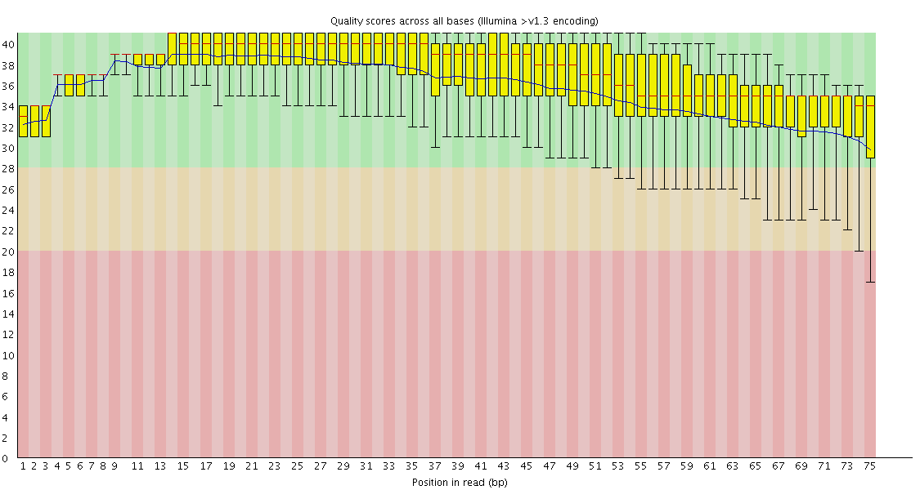
Quality

Slide 5
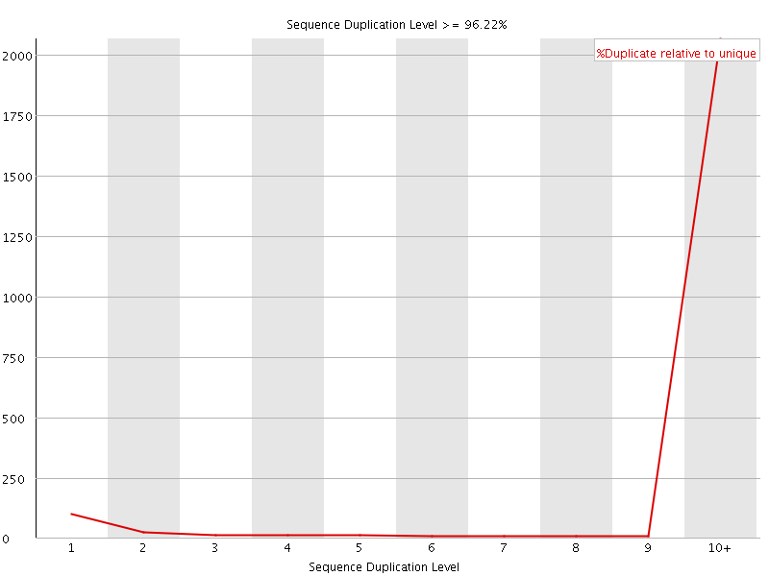

Slide 6
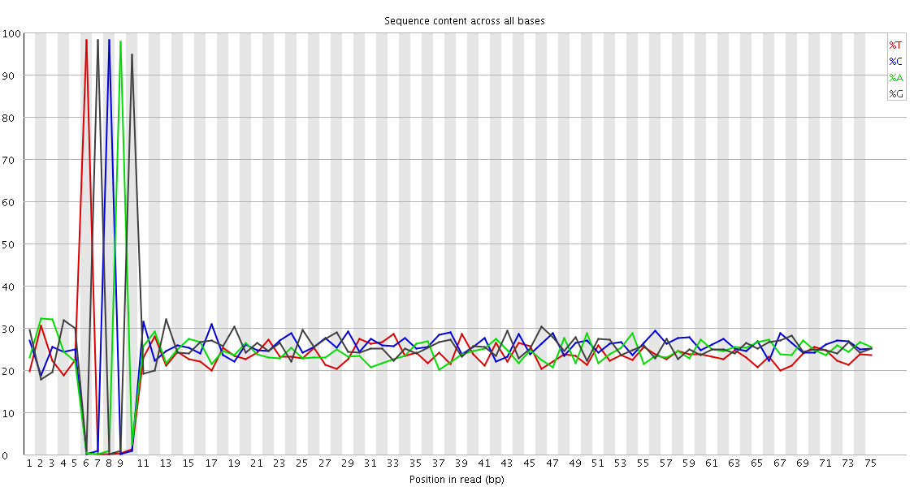
Base content
65bp
Barcode (5bp)
Restriction site (5bp)

Slide 7
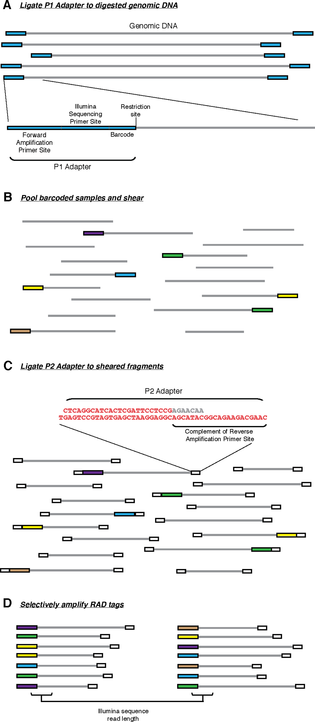
RAD sequencing
Baird et al. Plos One 2008

Slide 8
Pre-processing
process_radtags processes raw Illumina input:
De-multiplexing and removing barcodes
Sliding-window quality filter
Truncate reads
(alternatively – FASTX)
$ process_radtags -f in.fastq –o out_dir -i fastq –b barcodes -e sbfI -c -q -r –D
f — path to the input file if processing single-end seqeunces.
i — input file type, either 'bustard' for the Illumina BUSTARD output files, or 'fastq' (default 'fastq').
o — path to output the processed files.
b — a list of barcodes for this run.
e — specify the restriction enzyme to look for (either 'sbfI', 'pstI', 'ecoRI', or 'sgrAI').
c — clean data, remove any read with an uncalled base.
q — discard reads with low quality scores.
r — rescue barcodes and RAD-Tags.
D — capture discarded reads to a file.

Slide 9
Mapping
Use bowtie to map RAD tags to the genome
Allow a few mismatches – limits the number of SNPs per RAD tag!
Do not allow indels – polymorphic indels will not be found!

Slide 10
Stacks pipeline
Use RAD tags to the genome
ustacks (unique stacks): Builds loci de novo and detects haplotypes in one individual
cstacks (catalog stacks): Merges loci from multiple individuals to form a catalog
sstacks (search stacks): Matches loci from an individual against a catalog
pstacks (population stacks): Takes cleaned reads aligned to a reference genome, builds stacks based on the genomic locations of the reads, and detects haplotypes in one individual

Slide 11
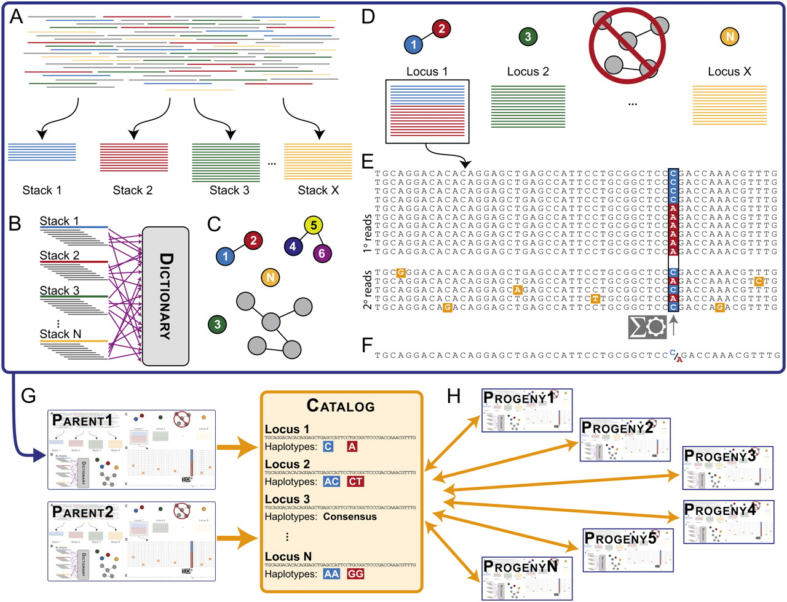
Catchen*
Catchen et al. G3 2011
Notes:
Stacks schematic. (A) The ustacks program forms stacks in an individual from short sequencing reads (cleaned by process_radtags.pl) that match exactly. (B) The ustacks program breaks down the sequence of each stack into k-mers and loads them into a dictionary. The ustacks program breaks down each stack again into k-mers and queries the k-mer Dictionary to create a list of potentially matching stacks, which can be visualized as nodes in a graph connected by the nucleotide distance between them. (C) ustacks merges matched stacks to form putative loci. (D) ustacks matches secondary reads that were not initially placed in a stack against putative loci to increase stack depth. An SNP model in ustacks checks each locus at each nucleotide position for polymorphisms. (E) ustacks calls a consensus sequence and records SNP and haplotype data. (F) The cstacks program loads stacks from the parents of a genetic cross into a Catalog to create a set of all possible loci in a mapping cross. (G) sstacks matches map cross progeny against the Catalog to determine the haplotypes at each locus in every individual in the cross.

